Slide 1
Set designer
Mariam AlQassimi

Slide 2
Set designer
The Set Designer is the Draftsman, often an Architect, who realizes the structures or interior spaces called for by the Production Designer.

Slide 3

Brain baker

Slide 4
Brain baker
Art Director / Set Designer / Architect
Education
North Carolina State University Master of Architecture, 1997 – 1998
Pennsylvania State University Bachelor of Architecture, 1990 - 1996

Slide 5

The hunger games

Slide 6

The last song

Slide 7

Heart of dixie

Slide 8

One tree hill

Slide 9

Work example 1

Slide 10

Work example 2

Slide 11

Work example 3

Slide 12

Work example 4

Slide 13
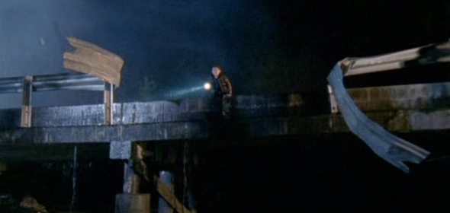
Work example 5

Slide 14
Thank you
Mariam alQassimi

