Slide 1
Creative Director
Mashael Aamer H00151167

Slide 2
Also known as the Production Designer
is responsible for:
creating the physical.
visual appearance of the film – settings.
To achieve the look of the film.

Slide 3
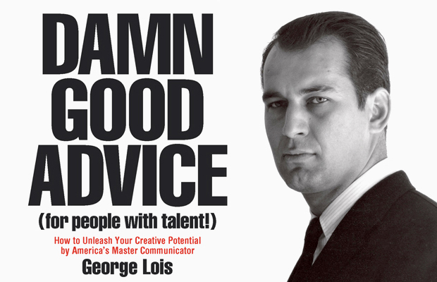
George Lois is advertising’s most famous art director

Slide 4
He has received the Lifetime Achievement Award from the American Institute of Graphic Arts.

Slide 5
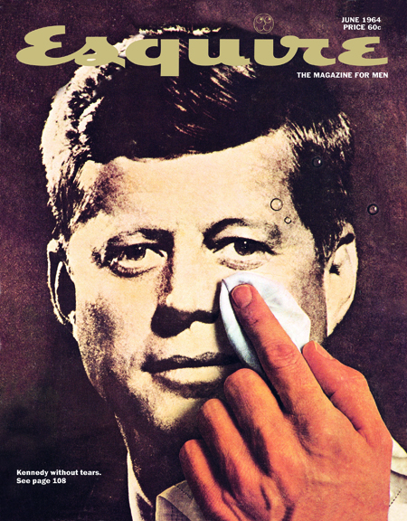
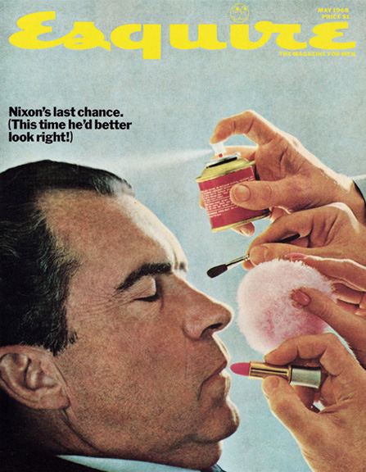
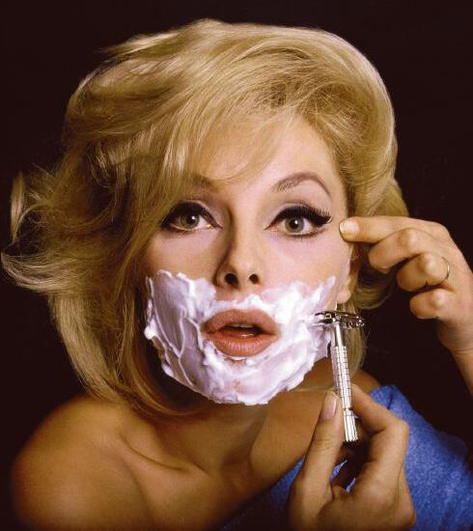
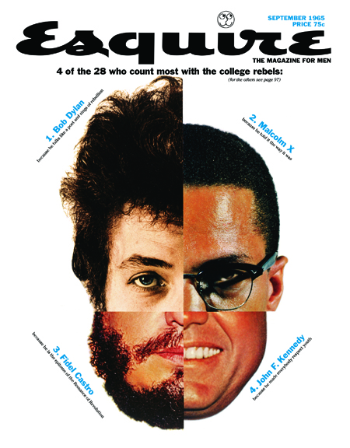

Slide 6
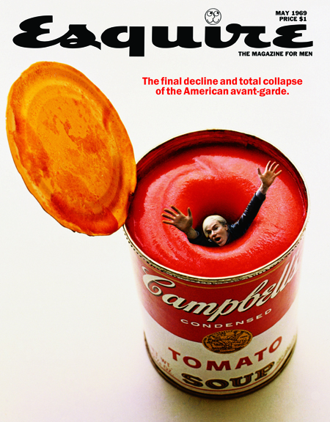
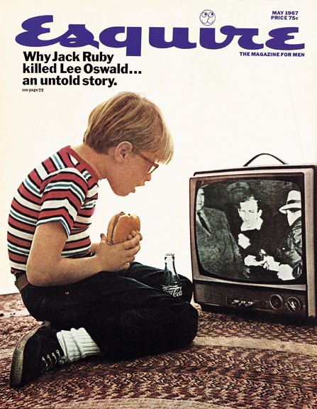

Slide 7
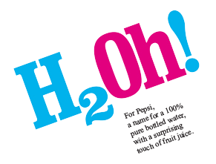

Slide 8
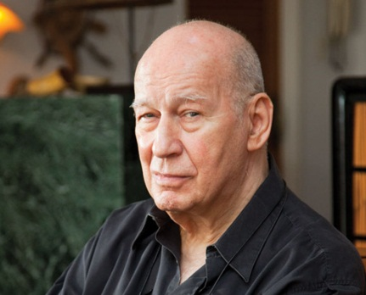
quotes
“Creativity can solve almost any problem. The creative act, the defeat of habit by originality, overcomes everything.” George Lois

Slide 9
Any question?
And thank you for your time !

