Slide 1
Famous Location manger
Maryam Rashed Altenaiji
H00157657

Slide 2
Responsibility for Location Manager
It an integral part of every film set
Oversees the Locations Department and its staff, typically reporting directly to :
Production Manager
Assistant Director

Slide 3
Best location managers in Hollywood
Alexander Cox
Anissa Mehnert
Gary Swim
Jacqueline Butryn
Matthew Bowden

Slide 4
Alexander Cox
Filmography by TV series for
The Lady (2011) (location manager: UK)
Beautiful People" (location manager) (6 episodes, 2009)
"Not Going Out" (location manager) (1 episode, 2009)

Slide 5
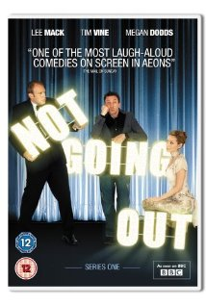
Picture

Slide 6
The lady Film
http://www.youtube.com/watch?v=BOPhgANP3EA

Slide 7
Recourse
http://www.imdb.com/name/nm0184895/filmoseries
http://www.ranker.com/list/famous-location-managers/reference
http://www.youtube.com/watch?v=BOPhgANP3EA

